Slide 1
Introduction to microservice architecture

Slide 2
What are microservices?
Microservices, also known as the microservice architecture, is an architectural style that structures an application as a collection of small autonomous services
Each service implements a single business capability
Radical solution for Monolithic Architecture

Slide 3
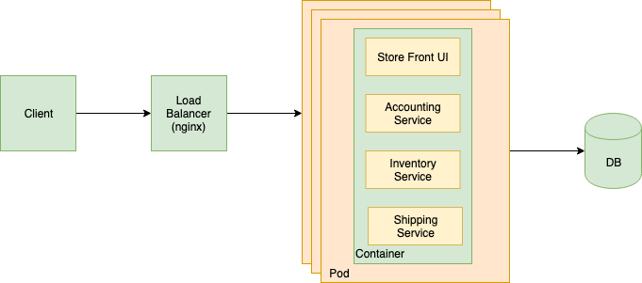
Monolithic Architecture
[+] Low entry level for developers
[+] Easy to develop
[+] Simple to scale
[+] Simple to deploy
[-] Increasing code complexity
[-] Difficult to evolve in terms off patterns and technologies
[-] One dimensional scale
[-] Difficult to scale development
[-] Overloaded container

Slide 4
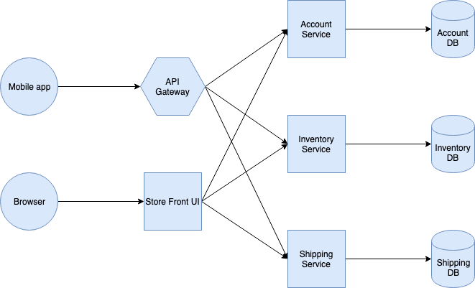
Microservice Architecture
[+] Separation of concerns
[+] Technology agnostic
[+] Simple Better to scale
[+] Easy to maintain and develop
[-] Complexity of creating distributed system
[-] High entry level for developers

Slide 5
Microservices Advantages: Separation of concerns
Decoupling on infrastructure level
Owned by a small teams
Independent development and deployment cycles
Easy to maintain and develop

Slide 6
Microservices Advantages: Technology agnostic
Can be built using different languages and platforms
Does not coupled to specific DB
Can use different methods of communication

Slide 7
Microservices Advantages: Services are easy better to scale
Easy to detect bottleneck
Each service can be scaled independently
You can choose technology for every microservice according to it business needs. You can focus on solving disc/memory/cpu intensive operations for each service

Slide 8
Microservices Advantages: Easy to maintain and develop
Simple application
Easier to make changes in existing code base due to it smaller size
Updating frameworks and libraries is no longer a complex problem
Smaller team and specific owners
Bigger teams are less efficient due to increased communication links n(n-1)/2
Smaller regression

Slide 9
Complexity of creating distributed system
Service discovery
Messaging
Scaling
Tracing and logging
Data consistency
Health check
Versioning

Slide 10
Service discovery: Problem
How does client of the service discover the location of service instance?
The number of services instances and their locations changes dynamically.
Virtual machines and containers are usually assigned dynamic IP addresses.
The number of services instances might vary dynamically.

Slide 11
Service discovery: Client-side service discovery
Technologies:
DNS
HAProxy
Nginx
Netflix Eureka
Apache ZooKeeper

Slide 12
Service discovery: Server-side service discovery
Technologies:
DNS
Nginx
AWS ELB
Netflix Eureka
Apache ZooKeeper

Slide 13
Messaging: common solutions
HTTP/REST
RPC
Message Queue

Slide 14
Messaging: HTTP/REST
Advantages:
HTTP is a standard (RFC 7231)
Easy to understand for humans
Most languages/platforms have built-in clients and server
Synchronous
Disadvantages:
Big messages
Slow, mostly because of handshake
No built-in contracts
REST/HATEOAS is not a standard

Slide 15
Messaging: RPC
Advantages:
Remote calls are implicit
Small messages
Transport-agnostic
Disadvantages:
Depends on client libraries
No specific standard
Difficult to extend
Difficult to debug

Slide 16
Messaging: Message Queue
Advantages:
Flexible
Request buffer
Time independence
Fault tolerance
Message prioritization
Broadcasting
Exclusive queues
Loose coupling
Simple infrastructure
Disadvantages:
MQ service can be a bottleneck
Message size is limited

Slide 17
Messaging
You are not limited to use only one approach

Slide 18
Scaling
This is DevOps problem
Load balancing
AWS Fargate (ECS)
Kubernetes
Mesos

Slide 19
Tracing and logging
Problem
Each service has its own log storage
Difficult to trace distributed operations
Solution
Log Aggregation
Logstash
AWS CloudWatch
Correlation ID

Slide 20
Data consistency
CAP theorem. In distributed systems you can only have 2 of the 3: Consistency, Availability and Partition Tolerance
Eventual consistency
Two phase commit (2PC)
Saga
Solves the problem
Increase coupling (e.g. all service should be online)
No (easy) rollbacks (compensating transactions) and canceling

Slide 21
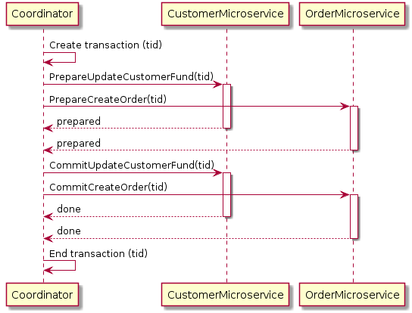
Two phase commit
Solves the problem with impact to availability

Slide 22
Saga
Solves the problem
Increase coupling (e.g. all service should be online)
No (easy) rollbacks (compensating transactions) and canceling
Additional logic inside services

Slide 23
Health check
Services should have Health Check endpoint
Health Check is usually done on LB side

Slide 24
Versioning
Be aware about breaking changes. Your service is a dependency of other services
Usually there is a need to maintain old version of specific services
Use routing

Slide 25
When to use?
Usually never
For big teams (15+ engineers)
When an application has a lot of independent features
In most of the cases, Service Oriented Architecture (SAO) is more than enough.

